Slide 1


Unity 3D Course
Lection 5.2D Mode & Particles

Slide 2
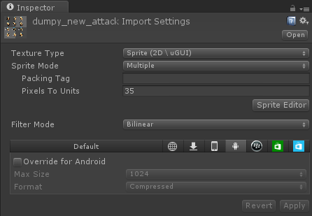
2D Mode
Lection 5.2D Mode & particles
Editor Settings
Camera differences
Sprites
Sprite Editor
Notes:
Project settings editor 2d/3d few words..
Orthographic camera , switching b/n 2d and 3d mode
Importing sprites properties
http://docs.unity3d.com/Manual/SpriteEditor.html
Cut few Sprites with sprite editor(show all slice types)

Slide 3
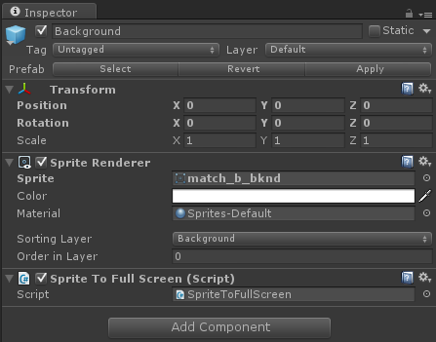
Layers
Lection 5.2D Mode & particles
Order of rendering
Sorting layer
Order in layer
zIndex
Notes:
Show few examples for sorting layers etc…
Access them using scripts in the examples.
...sprite.sortingLayer

Slide 4
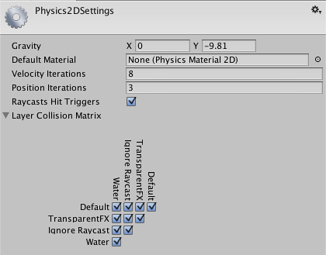
2D Physics
Lection 5.2D Mode & particles
2D Physics Manager
2D Rigidbody
2D Collisions
Notes:
Show and explain all properties in 2d physics manager
Explain all in 2d rigidbody
Show all methods for 2dCollisons
Make one example of all in Unity

Slide 5

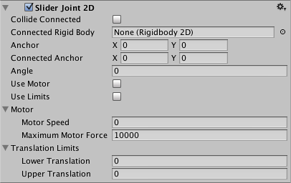
2D Physics
Lection 5.2D Mode & particles
2D Physics material
2D Joints
Spring
Distance
Hinge
Slider
Wheel
2D Character controller
Notes:
Demonstrate physics material 2d
http://docs.unity3d.com/Manual/class-PhysicsMaterial2D.html
Demonstrate all of the new joints types in Unity
http://docs.unity3d.com/Manual/class-DistanceJoint2D.html
http://docs.unity3d.com/Manual/class-SliderJoint2D.html
http://docs.unity3d.com/Manual/class-WheelJoint2D.html
Make one character with two colliders like the Unity trainings and Unity Course Game project…

Slide 6
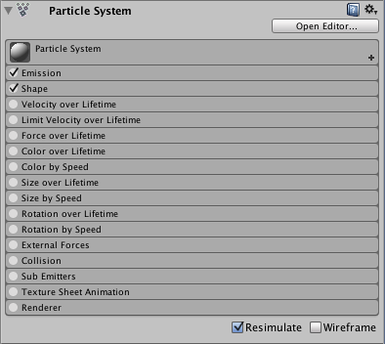
Particles
Lection 5.2D Mode & particles
Shuriken particles system
Multiple particles
Particle editor
Example smoke
Particle scripting
Notes:
http://docs.unity3d.com/Manual/class-ParticleSystem.html
Also explain particle editor
Go over every property and explain
Make example smoke(smoke scene in the course example project)
No Legacy particles will be used
http://docs.unity3d.com/ScriptReference/ParticleSystem.html

Slide 7
Useful links
http://docs.unity3d.com/Manual/class-SpriteRenderer.html
http://unity3d.com/learn/tutorials/modules/beginner/2d/sprite-editor
http://docs.unity3d.com/Manual/class-TagManager.html
http://docs.unity3d.com/Manual/class-Rigidbody2D.html
http://unity3d.com/learn/tutorials/modules/beginner/2d
http://docs.unity3d.com/ScriptReference/ParticleSystem.html

